Slide 1

How Does Being a Data Scientist Make a Difference in our Lives?
By LAJ
(Lien Lai, Abi Akinlotan, Jennifer Carden)

Slide 2
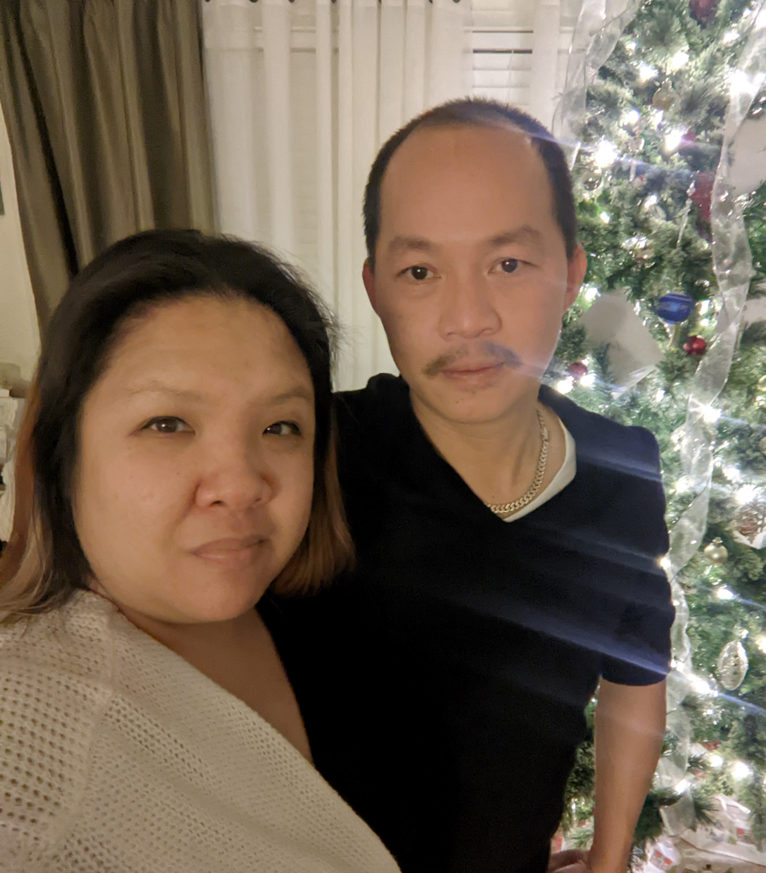

Lien Lai
I am married with three kids.
Oldest is 18 yr, middle is 16 yr and youngest is 9 yr.
All Girls!
My sister and niece(who is 10 yr.) live with us.
We do everything together.

Slide 3
What is a Data Scientist?
O’Neil, C., and Schutt, R. Doing Data Science
“More generally, a data scientist is someone who knows how to extract meaning from and interpret data, which requires both tools and methods from statistics and machine learning, as well as being human. She spends a lot of time in the process of collecting, cleaning, and munging data, because data is never clean.”
Shashi Upadhyay, CEO of Lattice
“Data Scientists are referred to as ‘UNICORNS’. They are professionals with a diverse skillset that is not commonly found in a single individual”

Slide 4
What skills are needed in Data Science?
Technical
Programing
Non-Technical
Strong Business Acumen
Knowledge of SAS and Other Analytical Tools
Adept at Working with Unstructured Data
Good Communication Skills
Great Data Intuition

Slide 5
What Does a Data Scientist Do?
Statistical analysis and computing
Process Large data sets
Machine Learning
Deep Learning
Data Visualization
Data Wrangling
Mathematics
Statistics
Programing
Big Data

Slide 6
How Will Data Science change the future?

Slide 7
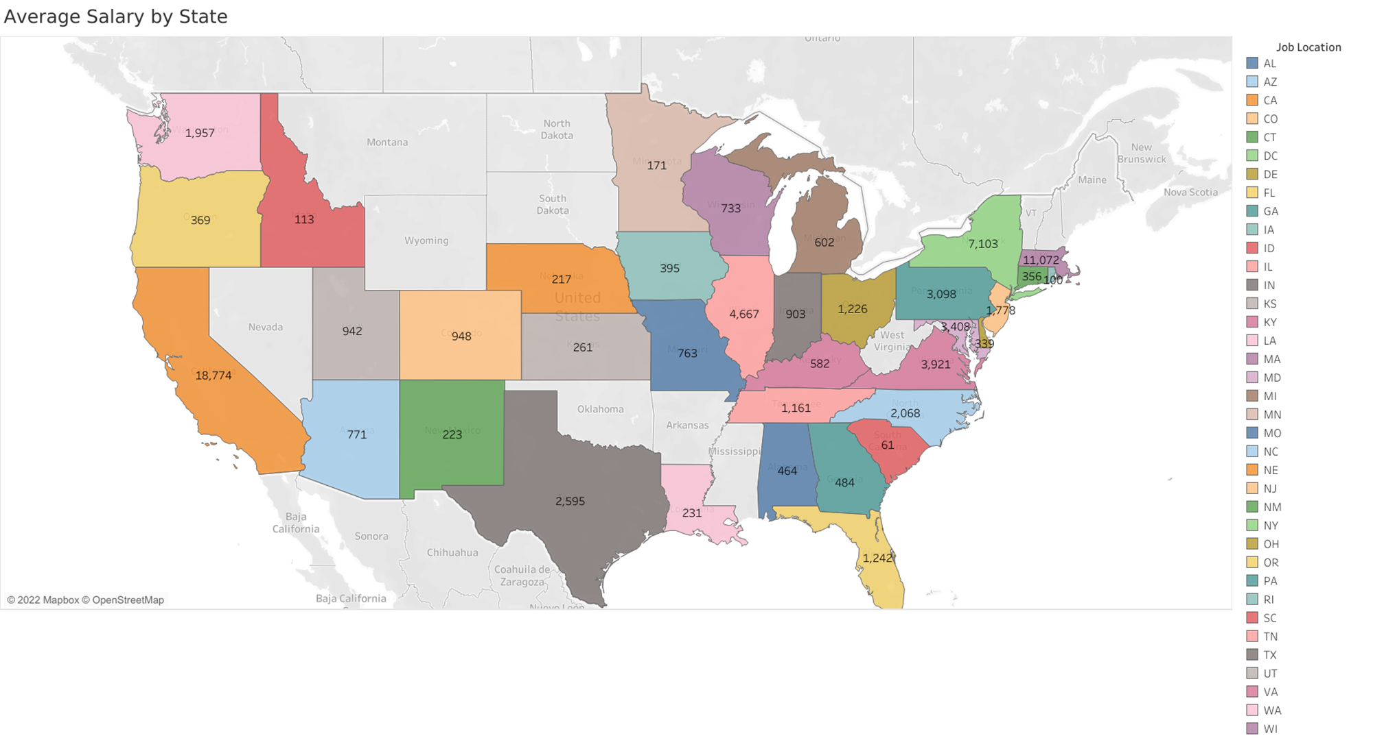
Avg Salary per State

Slide 8
Working on the West Coast Vs. East Coast
West Coast Salaries
East Coast Salaries

Slide 9
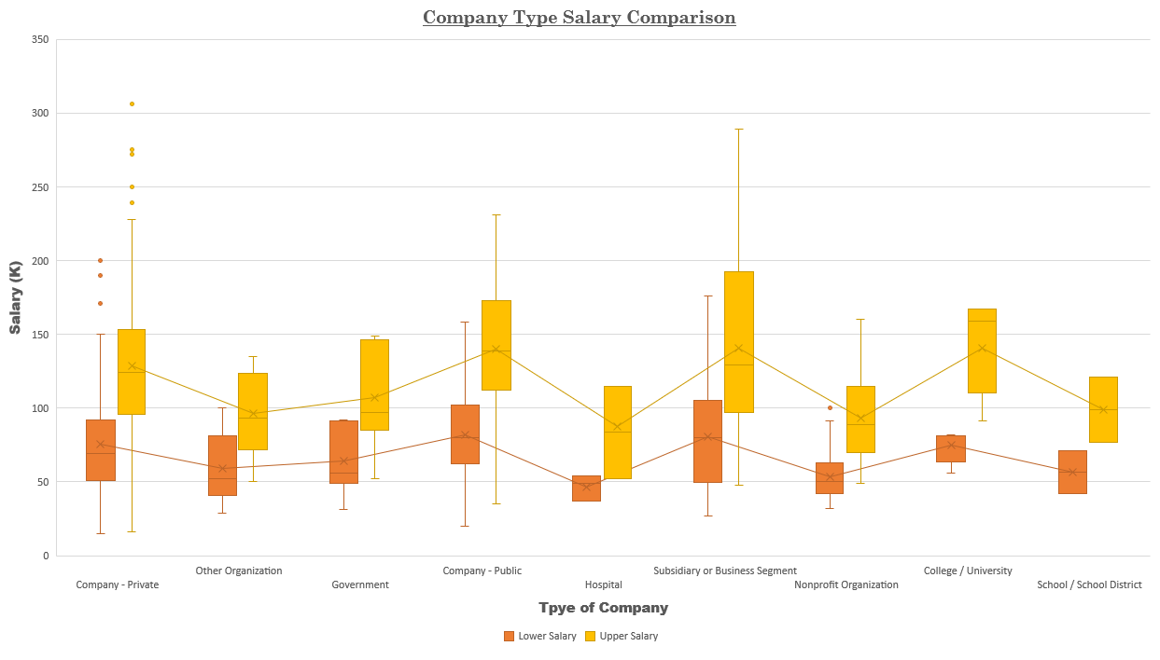

Slide 11
